Slide 1


Slide 2
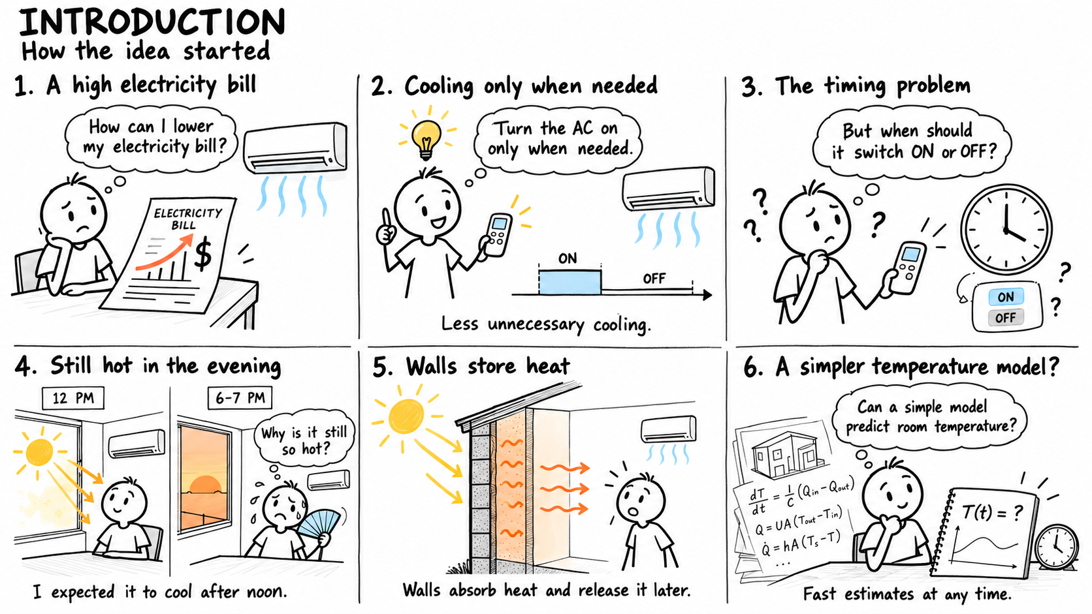

Slide 3
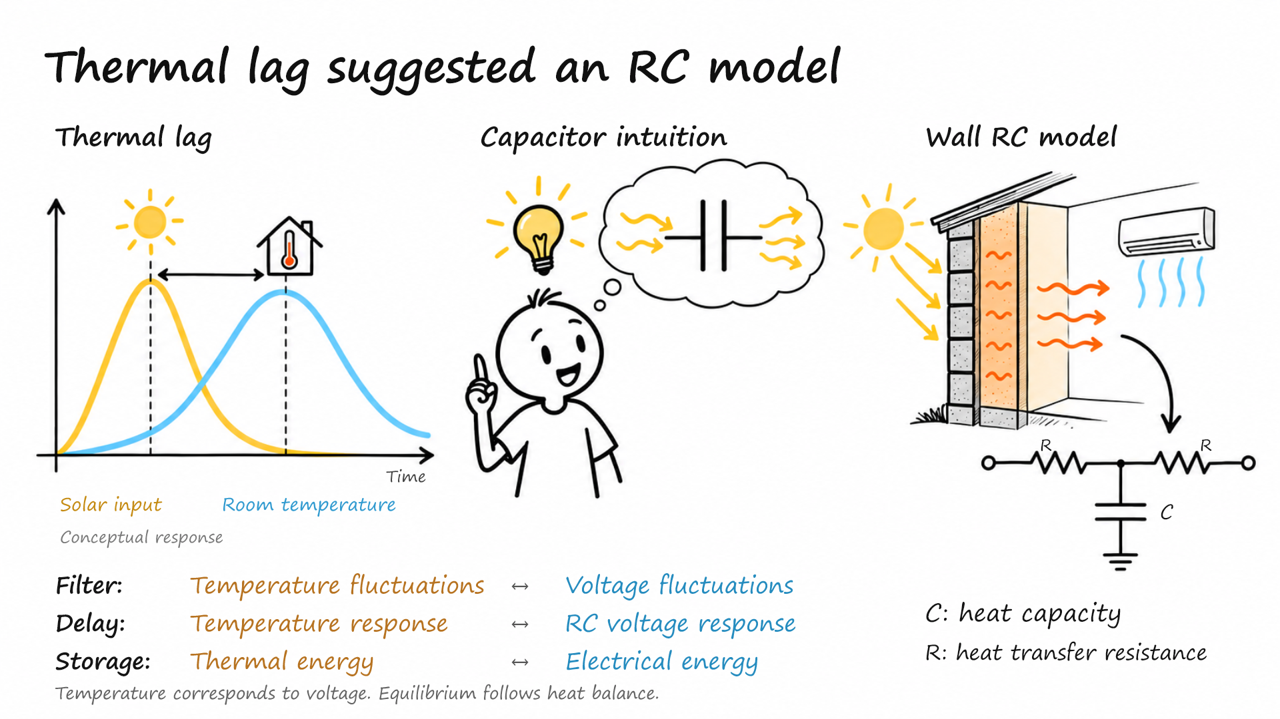

Slide 4
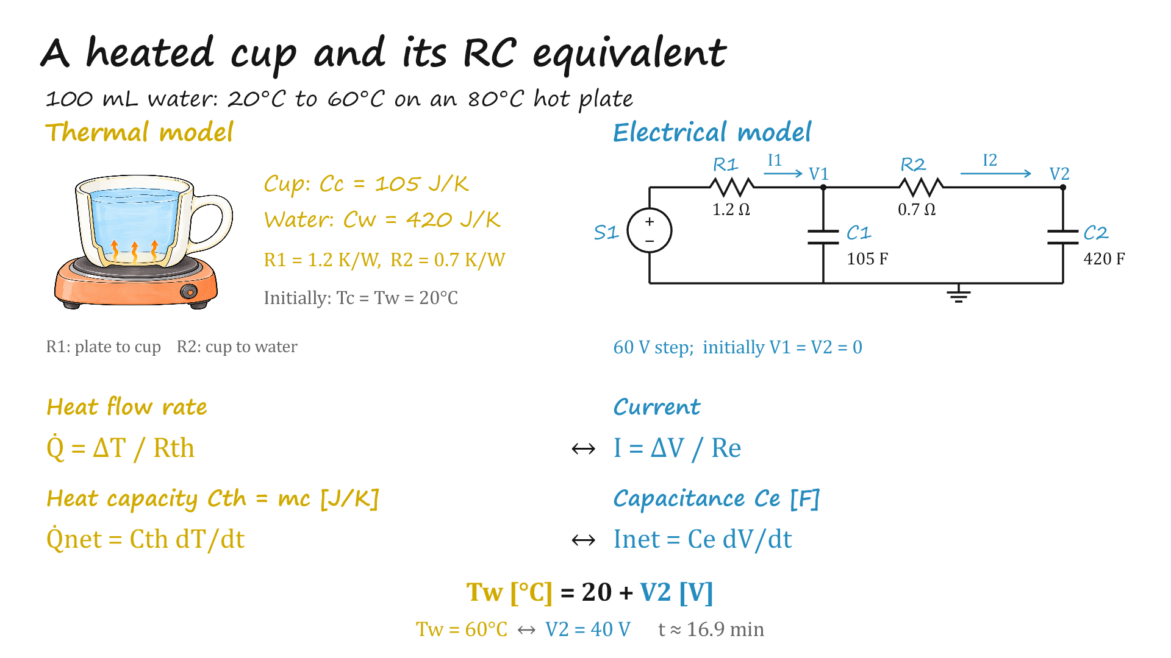

Slide 5
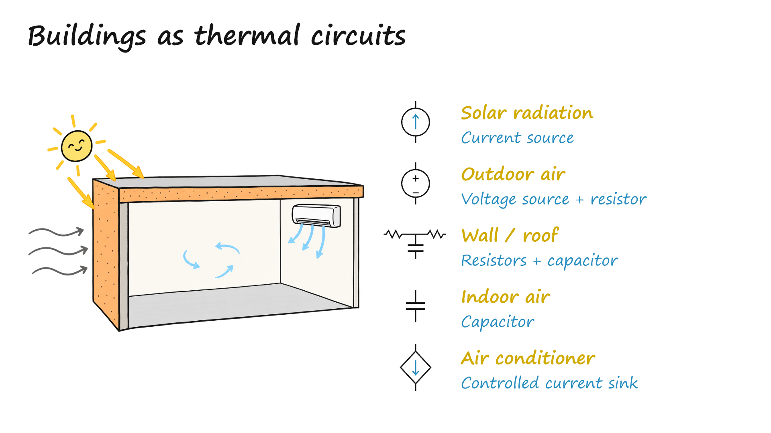

Slide 6
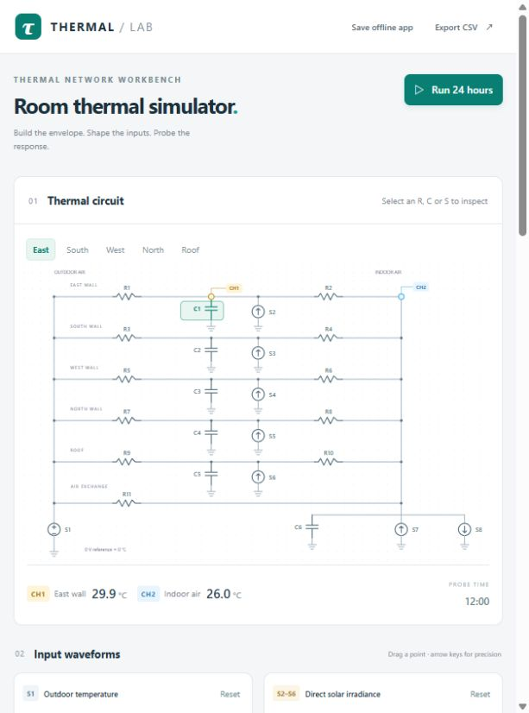
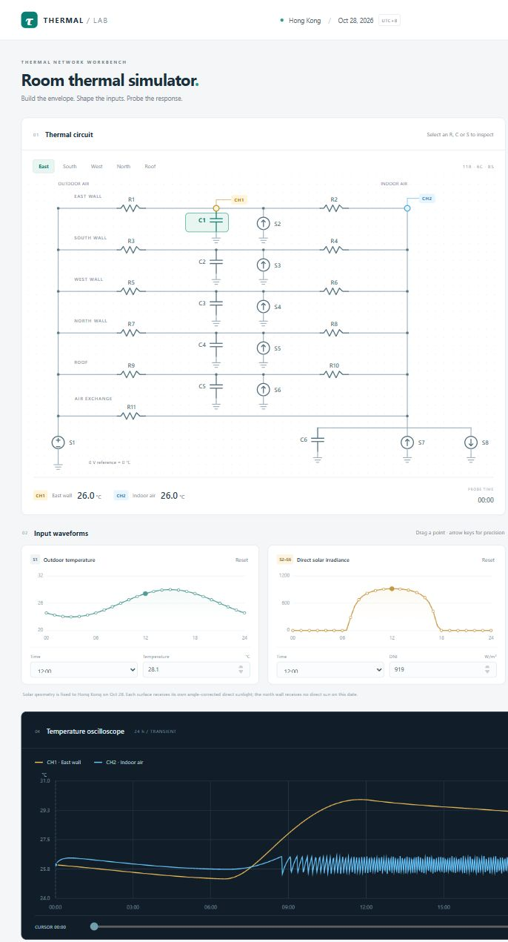
Thermal Circuit Lab
Open web app
An interactive RC simulator for testing materials, weather inputs and AC control.
Case: Hong Kong, 28 Oct 2026. Room: 10 × 10 × 5 m. Four walls and a roof.
Build the room model
Edit inputs and compare temperatures
Choose material presets and edit R, C and S.
Set cooling power and on/off thresholds.
Drag outdoor temperature and solar curves.
Compare wall and indoor air temperatures over 24 hours.

Slide 7
Summary & Declarations
Estimate a building’s indoor temperature for a chosen day,
even before construction is complete.
Guide AC and HVAC operation to help save energy
and shift demand away from peak electricity hours.
Design assistance
Open source on GitHub
Codex helped design this presentation.
https://github.com/helloworldLPH/MAEG5775-TEA-Pre
Contributions to the idea
Questions & feedback
Liu M.H., Song G.Y., Wang M.F.,
Wang Z.C. and Guo L.Y.
lipeiheng.phil@foxmail.com
1155241782@link.cuhk.edu.hk

